Slide 1



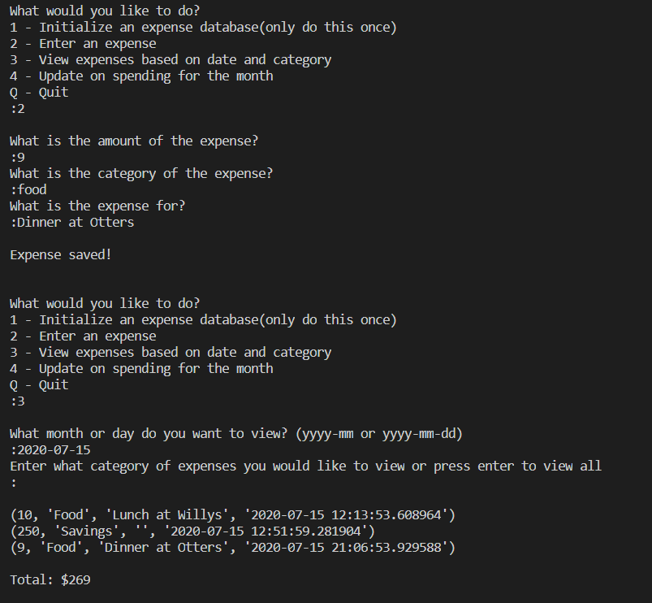
MyMoney Expense Tracker
- This app allows user to record expenses, view expense by date and category, and analyzes their spending habits over time. The goal of this app is to help people become more conscious spenders and take control of their money.
Developed by: Harrison Keener
Inspired by a tutorial from Sourav Johar
https://www.youtube.com/watch?v=sYBDJ15dNVc

